Slide 1
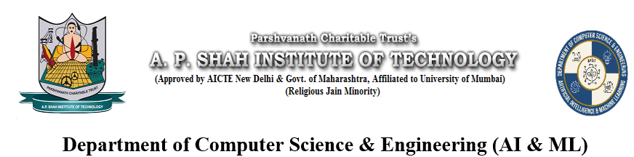
Broject — AI-powered developer collaboration matcher
Theme- SDG 9: Industry, Innovation, and Infrastructure
Group Members- Hrishikesh Kharkar, Haniya Akhtar, Ritik Pandey, Nishat Khan.
Subject Name- AAI
Subject Incharge- Dr Bharti Khemani

Slide 2
Outline
Introduction
Literature Survey
Limitations of existing systems
Problem statement
Proposed Methodology
Experimental Setup
Implementation
Results & Analysis
Conclusion and Future work
References

Slide 3
Introduction
The project focuses on building an AI-based collaboration and project recommendation system that connects developers based on their skills, experience, and working preferences. The system generates synthetic developer profiles and uses machine learning techniques to cluster users and recommend suitable collaborators.
With the increasing demand for collaborative development, especially in AI and software engineering, this system helps bridge the gap between individuals with complementary skills. It also suggests relevant project ideas using generative AI models, enhancing productivity and innovation.

Slide 4
Literature Survey
Author & Year | Techniques Used | Dataset | Key Result | Limitations
Xiang Wang, Xiangnan He, Meng Wang (2024) [1] | Sentence Transformers + interaction-aware embeddings | Multi-domain recommendation datasets | Outperforms traditional collaborative filtering | Requires large training data
Yongfeng Zhang, Xu Chen, Qingyao Ai, Yiqun Liu (2024) [2] | LLM + Collaborative Filtering | Real-world recommendation datasets | Improves performance by combining LLM | Higher computational cost; depends on pretrained CF
Chenyang Wang, Hongyu Zhao, Yong Liu (2023) [3] | Sequential recommendation + attention mechanisms | Scientific paper datasets | Captures dynamic user intent | Limited generalization beyond academic
Jianxun Lian, Xiaohuan Zhou (2025) [4] | Multi-interest learning + LLM-based | Benchmark + industrial datasets | Captures diverse user interests | Complexity in modeling multiple interests.
Zheng Liu, Yukun Chen, Zhaochun Ren (2023) [5] | content-based + collaborative | Review-based datasets | Better recommendation quality using sentiment analysis | Domain-dependent and requires extensive preprocessing

Slide 5
Limitations of existing Systems
1. Inability to Understand Contextual Skill Relationships:
Most systems rely on exact keyword matching, which fails to capture semantic similarity between skills. This results in poor matching accuracy and missed collaboration opportunities.
2. Absence of Intelligent User Grouping:
Traditional platforms treat users independently without grouping them based on similarity. Without clustering, systems cannot identify natural communities of developers, leading to inefficient matching.(Your system fixes this using GMM clustering on embeddings)
3. One-Dimensional Matching Approach:
Existing systems typically match users based only on skills or profiles. They ignore important real-world factors such as experience level, timezone compatibility, and work style preferences(Your hybrid scoring solves this by combining multiple factors)

Slide 6
Problem statement
The system intelligently matches developers based on skill similarity and overall compatibility, going beyond simple keyword matching. It uses machine learning to group users into meaningful clusters, making collaboration more efficient and relevant. By considering factors like experience, work style, and availability, it recommends the most suitable collaborators. Additionally, it generates personalized project ideas based on the combined skills of matched developers, encouraging innovation and teamwork.

Slide 7
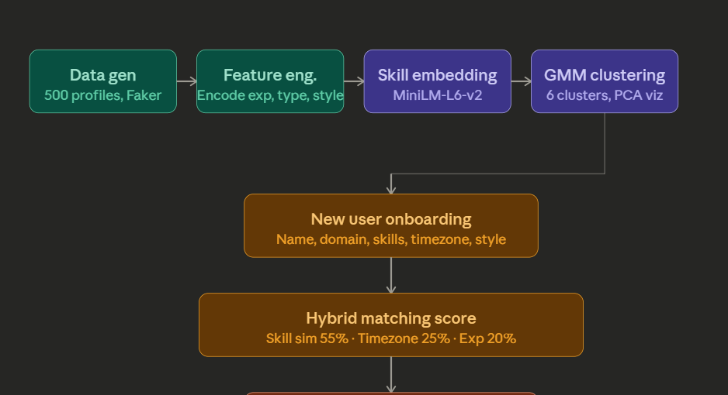
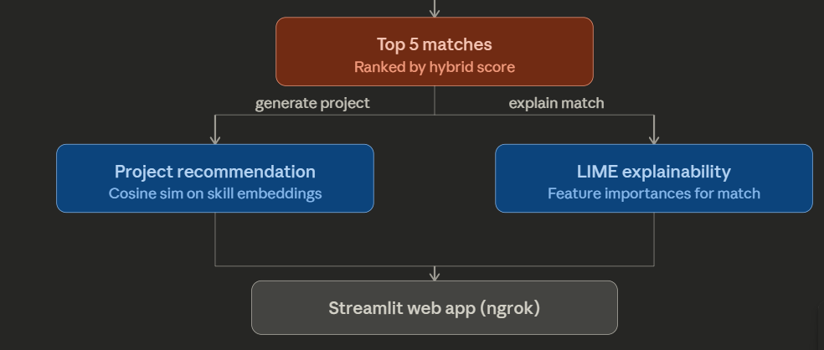
Proposed Methodology
Flowchart of Broject collaborator

Slide 8
Experimental Setup
🔹 Libraries and Tools Used
NumPy: Used for numerical operations and synthetic data generation
Scikit-learn:
  Gaussian Mixture Model (GMM) for clustering
  Cosine similarity for measuring skill similarity
  PCA (Principal Component Analysis) for cluster visualization
Sentence Transformers:
  Used for generating semantic embeddings of developer skills
Faker:
  Used to generate realistic synthetic developer profiles
Streamlit:
  Used to build an interactive UI for user input and displaying matches
Groq API / LLM Integration:
  Used for generating project ideas dynamically
🔹 Dataset Description
Each profile contains:
  Skills (text-based)
  Experience level (Beginner, Intermediate, Advanced)
  Timezone (IST, PST, EST)
  Work style (Fast Prototyper, Detail-Oriented, Idea Generator)
The dataset was designed to simulate real-world diversity in developer profiles

Slide 9
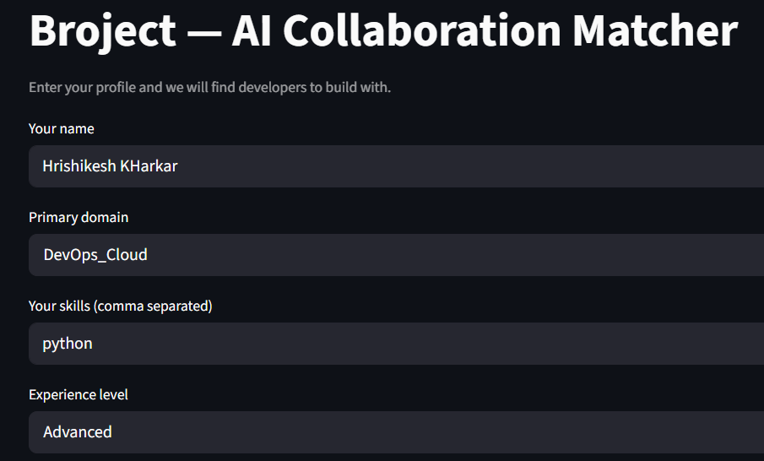
Implementation
Input Parameters

Slide 10
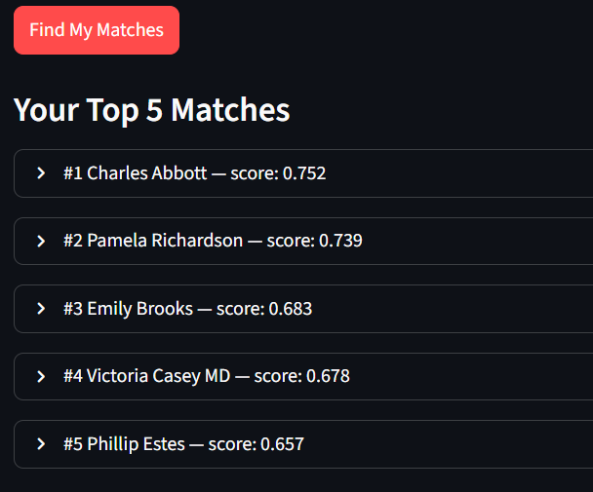
Matchmaking using clustering

Slide 11
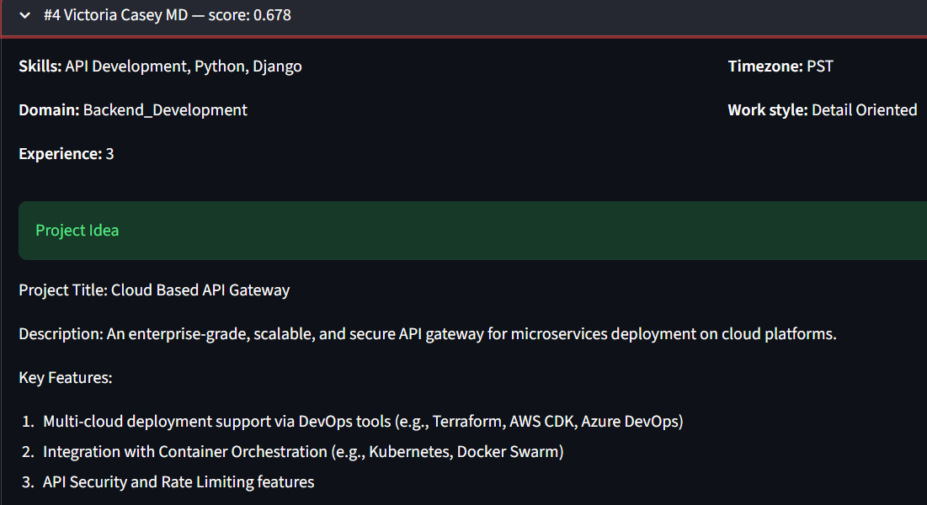
Generative Idea generation

Slide 12
Results & Analysis
The results of the proposed system demonstrate its effectiveness in intelligently matching developers and generating meaningful recommendations. The clustering process, implemented using the Gaussian Mixture Model (GMM), successfully grouped users into well-defined clusters based on their skill embeddings. This grouping enabled the system to reduce the search space and improve the relevance of matches. The PCA visualization of clusters clearly indicates distinct separation among user groups, confirming that the embedding and clustering approach effectively captures semantic similarities between developer skills.
The hybrid matching algorithm further enhances the system’s performance by combining multiple factors such as skill similarity, experience level, timezone compatibility, and work style. Compared to traditional similarity-based approaches, this multi-dimensional scoring mechanism produces more accurate and practical recommendations.

Slide 13
Conclusion
The project effectively demonstrates how AI techniques such as embeddings, clustering, and hybrid recommendation systems can be used to improve developer collaboration. By integrating generative AI, the system goes beyond matching and provides meaningful project ideas, making it highly practical and innovative.
Future Work
Use real-world datasets instead of synthetic data
Improve clustering using deep clustering methods
Integrate real-time collaboration platforms (GitHub, LinkedIn)
Enhance generative AI for more diverse and detailed ideas
Add recommendation explainability using LIME (already partially implemented)

Slide 14
References
[1] J. Vančura, et al., “beeFormer: Bridging Semantic and Interaction Representations for Recommendation Systems,” arXiv:2409.10309, 2024.
[2] J. Kim, et al., “A-LLMRec: Large Language Models Meet Collaborative Filtering for Recommendation,” arXiv:2404.11343, 2024.
[3] S. Santosa, et al., “S3PaR: Sequential Scientific Paper Recommendation Using Attention Mechanisms,” Knowledge-Based Systems, vol. 280, 2024.
[4] Y. Zhou, et al., “HyMiRec: Hybrid Multi-Interest Learning with Large Language Models for Recommendation,” arXiv:2510.13738, 2025.
[5] S. Roy, et al., “A Hybrid Recommendation System Using Transformers and Sentiment Analysis for E-commerce,” 2023.

Slide 15
Thank You...!!

